Slide 1





Psyliq
Internship
HR DATA Analytics
Navigating the Future through Data-Driven Insights
PRESENTED BY SUHAIL AHMED
linkedin.com/in/suhail-ahmed-cs/
github.com/suhail57

Slide 2

DESCRIPTION
As a Data Analyst Intern at PSYLIQ, my role is pivotal in deciphering the complexities of the company's recruitment strategy to bolster organizational success. I delve into analyzing critical aspects of the hiring process, such as rejection rates, interview efficiencies, and the nature of vacancies, which are instrumental in refining recruitment approaches. Entrusted with the evaluation of PSYLIQ's extensive historical hiring data, my mission is to unearth actionable insights that can streamline and enhance the recruitment framework. This endeavor aims to empower the Hiring Department with data-backed recommendations, fostering informed decision-making. My analysis is geared towards identifying trends and patterns that can optimize hiring tactics, thus attracting elite talent and contributing significantly to PSYLIQ's overarching ambitions for growth and operational excellence. This initiative underscores the value of data-driven strategies in achieving recruitment excellence and organizational goals.

Slide 3



APPROACH
Clarify the project's overall objectives and goals.
The project's goal is to enhance PSYLIQ's hiring strategies using a data-driven analysis. Starting with an ETL process, it involves extracting essential hiring data from PSYLIQ's records, including job roles, salary changes, and employment outcomes. During the transformation phase, data will be standardized and errors corrected using Power Query in Excel. The analysis in Power BI will focus on deep insights through advanced features, examining variables like departmental performance, marital status, and salary hikes using DAX for complex calculations. The final aim is to provide PSYLIQ's Hiring Department with actionable insights to optimize recruitment processes and attract top talent effectively.
ETL (Extract, Transform, Load)
DAX (Data Analysis Expressions)
Power Query
Empowering
Insights

Slide 4





TECH-STACK
EXCEL
POWER BI
A wide number of industries, including business, finance, education, and research, utilize Microsoft Excel extensively because of its versatility and diversity of uses.
Power BI, serves as a potent business analytics tool, aiding in data visualization and analysis to inform decision-making processes by professionals worldwide.

Slide 5

INSIGHTS
Brief discusses the key insights for the Project

Slide 6

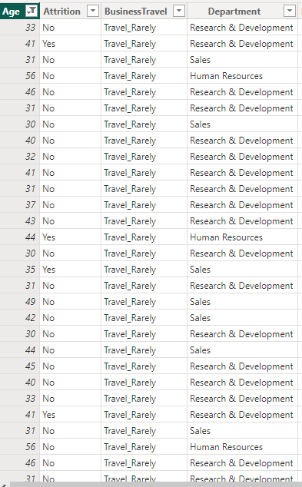
FILTERING EMPLOYEES AGED 30 AND ABOVE IN POWER BI
To filter employees aged 30 and above in Power BI, you would apply a filter to the 'Age' column in your dataset. In the visualization pane or the data tab, you would set the filter to only include rows where the 'Age' value is greater than or equal to 30. This action will refine the displayed data, ensuring that all subsequent analysis, reports, and visualizations consider only employees who meet this age criterion. It's a useful technique for focusing on a specific demographic, perhaps to analyze patterns related to more experienced staff, such as attrition rates, department distribution, or travel requirements for this age group within the organization.

Slide 7
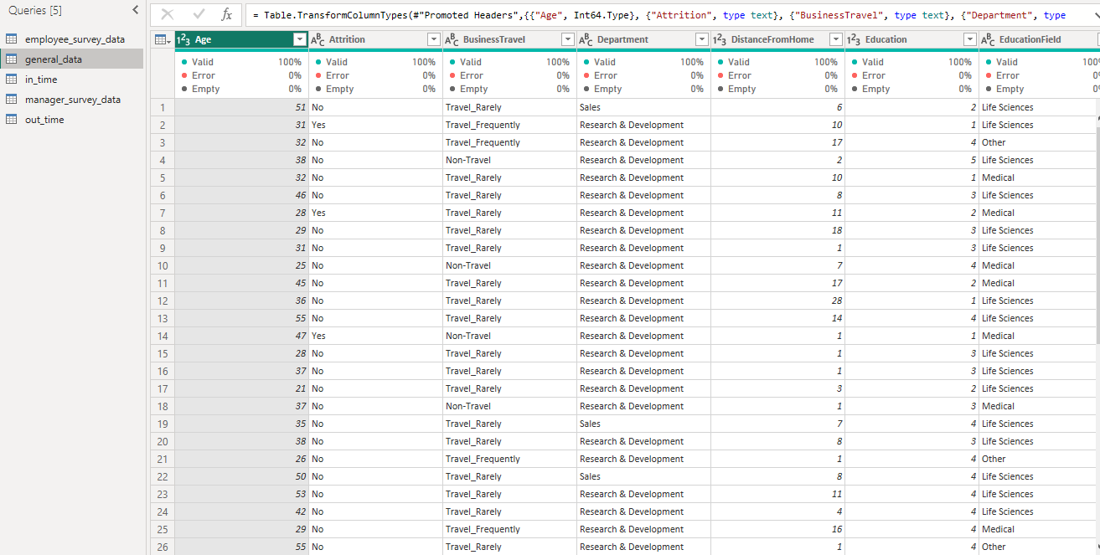
REMOVE THE NULL AND
EMPTY VALUES FROM DATASET
To ensure data integrity for our analysis, we employ the Transform Data feature in Power BI to remove rows with null or empty values. This crucial data cleansing step prevents potential inaccuracies and prepares the dataset for reliable analysis and reporting, supporting sound HR decision-making.

Slide 8
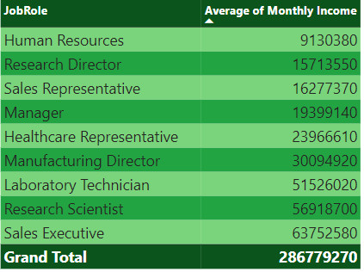
AVERAGE MONTHLY INCOME
BY JOB ROLE
The table presents a breakdown of average monthly incomes by job role, illustrating the salary distribution across various positions in the organization. It highlights the financial disparities between roles, serving as a reference for HR in compensation planning and strategy.

Slide 9
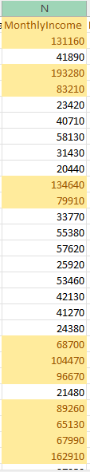
HIGHLIGHTING EMPLOYEES WITH MONTHLY INCOME ABOVE COMPANY
The image shows a column of monthly incomes with highlighted entries, indicating employees who earn above a particular benchmark. This visual tool is essential for quickly identifying high earners and assessing compensation patterns within the company.

Slide 10
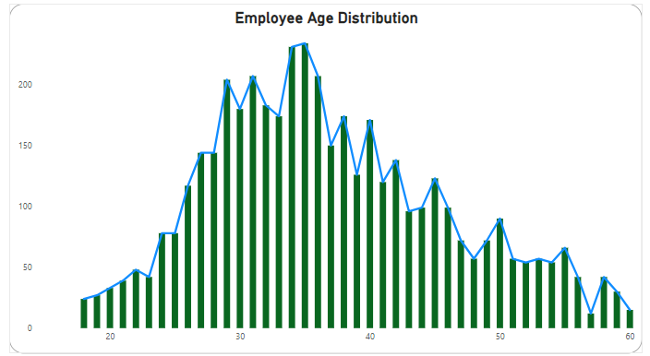
VISUALIZING EMPLOYEE AGE DISTRIBUTION
The graph titled "Employee Age Distribution" depicts the age profile of a company’s workforce. The bell-shaped distribution indicates a concentration of mid-career employees, with fewer younger and older workers, suggesting a mature workforce with implications for recruitment and succession planning.

Slide 11
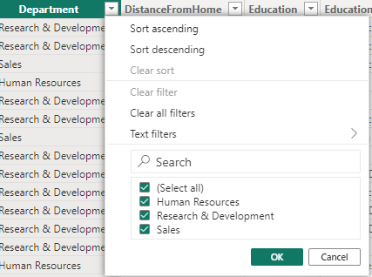
CLEANING MISSING OR INCONSISTENT DATA IN THE "DEPARTMENT" COLUMN
It’s shows a filter applied to the "Department" column, selecting only "Human Resources," "Research & Development," and "Sales." This step cleanses the dataset by excluding missing or inconsistent entries, crucial for precise HR data analysis.

Slide 12
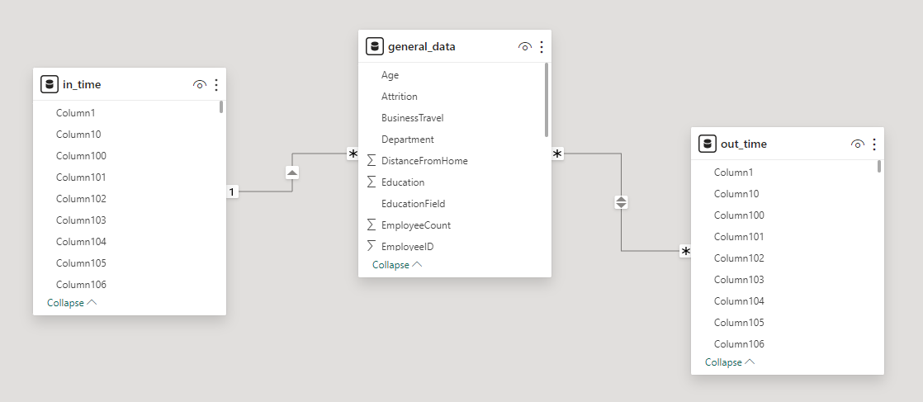
RELATIONSHIP BETWEEN EMPLOYEE ID IN EMPLOYEE AND TIME TRACKING DATA IN POWER BI
It’s shows a Power BI relationship model, linking 'EmployeeID' across 'general_data', 'in_time', and 'out_time' tables, essential for merging employee information with time tracking data for analysis.

Slide 13
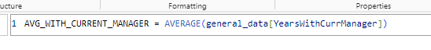
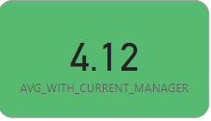
CALCULATING AVERAGE YEAR WITH
CURRENT MANAGER USING DAX
It’s show a DAX formula used in Power BI to calculate the average number of years employees have spent with their current manager. The result, displayed in a card visual, indicates that on average, employees have worked for 4.12 years under their current manager.

Slide 14
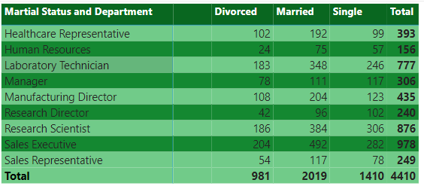
COUNT OF EMPLOYEES BY MARTIAL STATUS
AND DEPARTMENT
It’s displays a count of employees by marital status—Divorced, Married, Single—across various departments such as Healthcare, HR, and Research. It provides a clear depiction of the demographic composition of the workforce, which is crucial for HR in tailoring benefits and support programs.

Slide 15
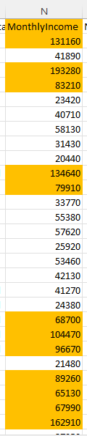
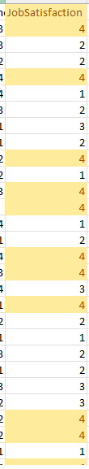
EMPLOYEE WITH ABOVE-AVERAGE MONTHLY INCOME AND JOB SATISFICATION
It’s show tables listing the monthly income and job satisfaction of employees. We are identifying those with above-average income and high job satisfaction. High income would mean more than the average of the numbers in the first image, while high job satisfaction is indicated by the highest number in the scale used in the second image.
MONTHLY INCOME
JOB
SATISFICATION

Slide 16
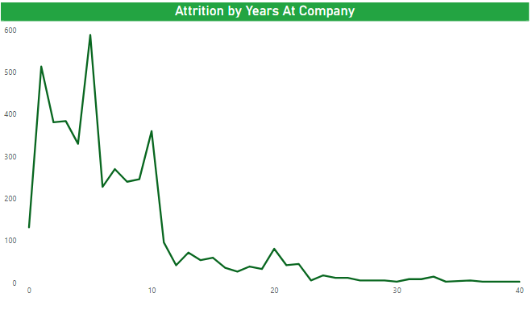
EMPLOYEE ATTRITION TREND OVER THE YEARS
IN POWER BI

Slide 17
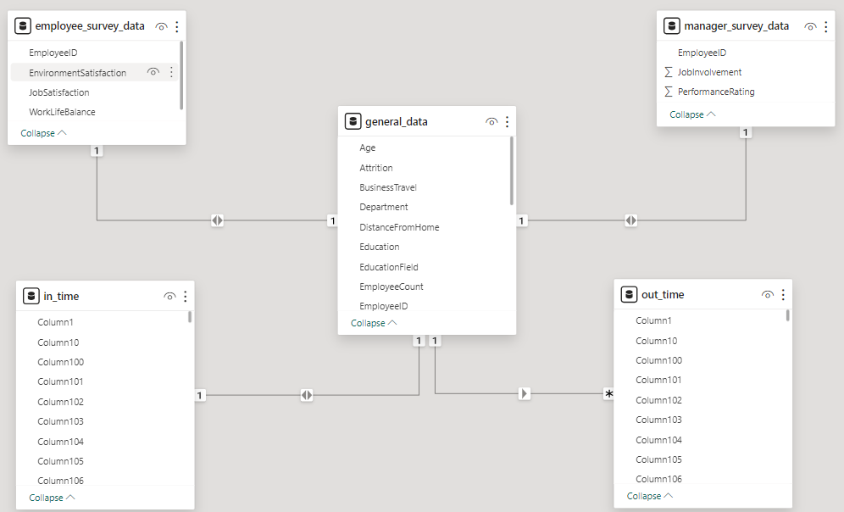
CREATING A STAR SCHEMA FOR DATASET
AND IT’S BENEFIT

Slide 18




CREATING A STAR SCHEMA:
BENEFITS AND PROCESS
Streamlining data analysis and reporting process for
improving comprehension and effiency
Identify Key Elements
Organize Dimension Tables
Connect Tables
Simplify Views
Recognize the main components of your data, like departments, employees, and time, which become dimension tables, and the measurable data, like sales or revenue, which becomes the fact table.
Break down dimension tables into smaller, focused tables, each representing a unique aspect, such as Department, Employee, or Time, with their specific details
Establish connections between dimension tables and the fact table using keys, Each dimension table should have a unique identifier that links to related records in the fact table.
Establishing simplified, flattened views of your data streamlines the reporting and analysis process, making it easier to comprehend.

Slide 19
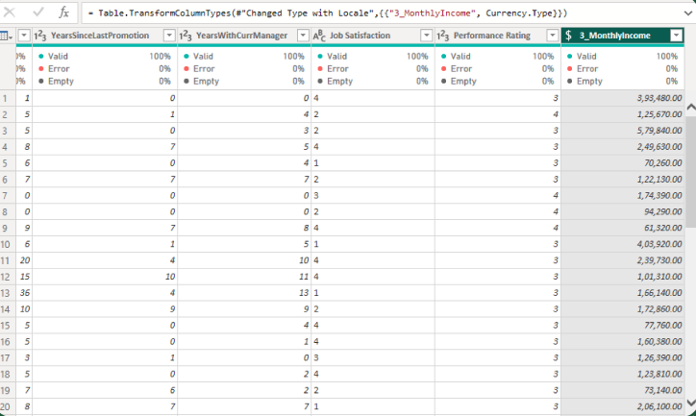
CALCULATING ROLLING 3-MONTH AVERAGE
MONTHLY INCOME USING DAX

Slide 20
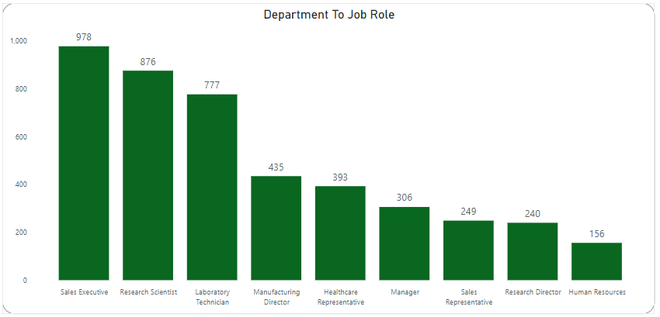
CREATING DEPARTMENT TO JOB ROLE
IN POWER BI

Slide 21
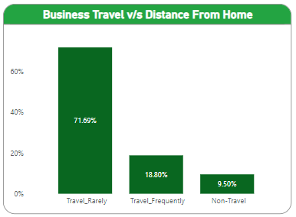
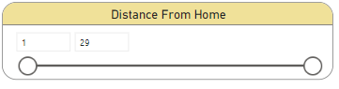
PARAMETERIZED QUERIES FOR FILTERING DATA
BY DISTANCE FROM HOME IN POWER BI

Slide 22









PARAMETERIZED QUERIES FOR DISTANCE-FROM-HOME FILTERING
Start by creating a new parameter in Power BI Desktop under the "Home" tab.
Make sure the data in your query reflects the filter you want based on this parameter.
Save your changes in the Query Editor.
Finally, add a slicer to your report view so users can interactively filter data using this parameter

Slide 23
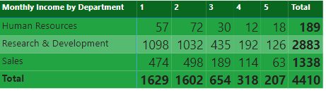
TOTAL MONTHLY INCOME BY DEPARTMENT
FOR EMPLOYEES WITH JOB LEVEL

Slide 24
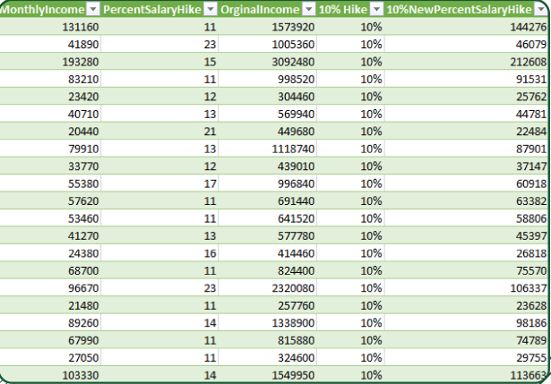
IMPACT OF 10% INCREASE IN PERCENT SALARY
HIKE ON MONTHLY INCOME

Slide 25



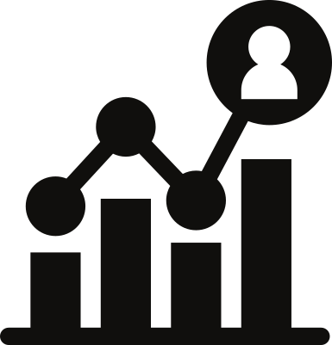


CREATING A WHAT-IF ANALYSIS FOR PERCENT SALARY HIKE
STEP 1
First, input all your data and the formulas you need.
STEP 2
Next, find the cell where you calculated the Percent Salary Hike.
STEP 3
Then, go to the "Data" tab and choose "What-if Analysis" and then "Data Table."
STEP 4
Now, input the cells containing the original data and the Percent Salary Hike into the appropriate boxes.
STEP 5
Now, input the cells containing the original data and the Percent Salary Hike into the appropriate boxes,

Slide 26

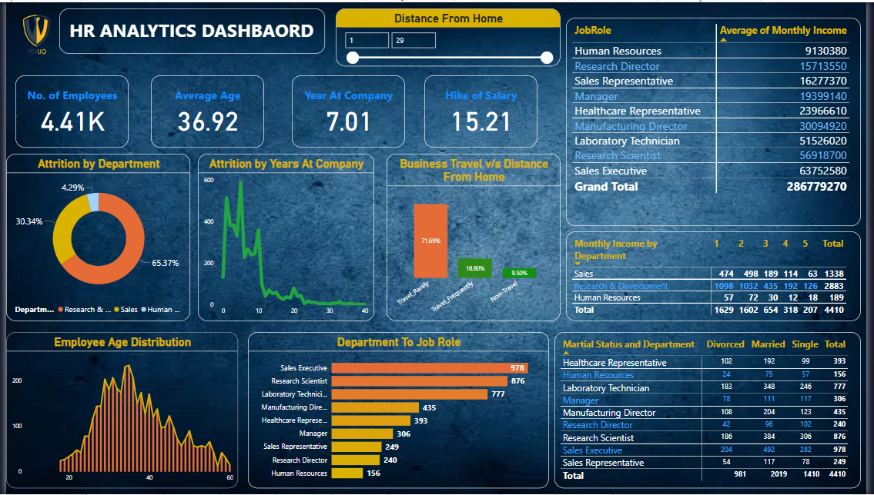
DASHBOARD

Slide 27
VERIFYING DATA ADHERENCE TO PREDEFINED SCHEMA AND ACTIONS FOR INCONSISTENCIES
Verifying data adherence to a predefined schema involves several steps:
Schema Verification: Compare the data fields with the predefined schema to ensure they match in terms of data types, formats, and allowed values.
Consistency Checks: Identify any inconsistencies such as missing values, duplicate entries, or outliers that deviate from the expected patterns outlined in the schema.
Error Handling: Address any data inconsistencies by implementing appropriate error-handling mechanisms, such as data cleansing techniques or validation rules.
Record Keeping: Maintain records of any inconsistencies found and the actions taken to resolve them tor future reference and transparency.
Iterative Improvement: Continuously monitor and refine the data validation process to maintain data quality and ensure ongoing adherence to the predefined schema.

Slide 28



MAXIMIZING HR ANALYTICS ENGAGEMENT
Targeted Messaging
Strategic Engagement
Value-driven Content
Tailor communication to address HR professional's pain points, highlighting how your analytics solutions address their specific challenges.
Engage with HR audiences on platforms like Linkedin and HR forums, offering valuable Insights and resources related to data analysis in HR.
Provide HR professionals with data-driven content and expertise, showcasing how your analytics tools can optimize workforce management and drive organizational growth

Slide 29

CONCLUSION
Employee Age Distribution revealed peaks in the 34-36 age group and lows in the 58-60 range. Average Monthly Income Analysis unveiled the top salary for Manufacturing Director at, 183 and the lowest in Human Resources at, 528. Marital Status Exploration discovered the prevalence of married employees, with Research and Development leading at 1,350, contributing to the overall highest count of 2,883. Attrition Trends Examination revealed a peak of 588 occurrences over the years. Establishing a star schema and employing hierarchical drill-downs in Power BI streamline data organization and facilitate deeper analysis, while also enabling dynamic filtering, and enhancing data exploration and analysis. Ultimately, these findings empower HR professionals with actionable insights to optimize workforce management strategies and foster organizational growth, benefiting Psylią by facilitating the implementation of special steps. and providing valuable advice.

Slide 30

Psyliq
Internship
Thank
You

